Slide 1
Section 12.3 - Measures of Dispersion
Find the range of a data set.
Calculate the standard deviation of a data set.
Interpret measures of dispersion.
Sometimes we want to look at a measure of dispersion, or spread, of data. Two of the most common measures of dispersion are the range and the standard deviation.

Slide 2
Range
For any set of data, the range of the set is given by
Range = (greatest value in set) – (least value in set).
The two sets below have the same mean and median (___). Find the range of each set.
Set A | 1 | 2 | 7 | 12 | 13
Set B | 5 | 6 | 7 | 8 | 9
Solution
Range of Set A: ___ – ___= ___.
Range of Set B: ___ – ___ = ___.

Slide 3
Standard Deviation
One of the most useful measures of dispersion, the standard deviation, is based on deviations from the mean of the data.
Find the deviations from the mean for all data values of the sample 1, 2, 8, 11, 13.
Solution
The mean is ____. Subtract to find deviation (data value – mean)
Data Value | 1 | 2 | 8 | 11 | 13
Deviation
___ – ___ = ___
The sum of the deviations for a set is always ___.

Slide 4
Standard Deviation
The variance is found by summing the squares of the deviations and dividing that sum by n – 1 (since it is a sample instead of a population).
The square root of the variance gives a kind of average of the deviations from the mean, which is called a sample standard deviation.
It is denoted by the letter s. (The standard deviation of a population is denoted the lowercase Greek letter sigma.)

Slide 5
Calculation of Standard Deviation
Let a sample of n numbers x₁, x₂,…x_{n} have mean Then the sample standard deviation, s, of the numbers is given by
Data value, x
Sample mean, x-bar
Sample standard deviation, s
Number of data items, n

Slide 6
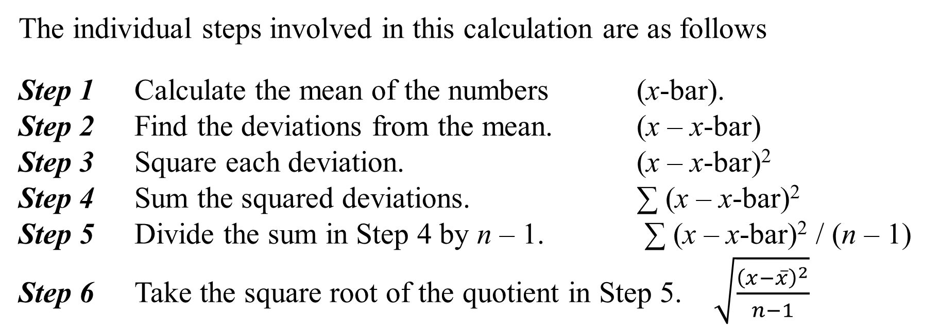
Calculation of Standard Deviation
The individual steps involved in this calculation are as follows
Step 1 Calculate the mean of the numbers (x-bar).
Step 2 Find the deviations from the mean. (x – x-bar)
Step 3 Square each deviation. (x – x-bar)²
Step 4 Sum the squared deviations. ∑ (x – x-bar)²
Step 5 Divide the sum in Step 4 by n – 1. ∑ (x – x-bar)² / (n – 1)
Step 6 Take the square root of the quotient in Step 5. $\sqrt{\frac{{\left(x−\overline{x}\right)}^{2}}{n−1}}$

Slide 7
Example: Finding a Sample Standard Deviation
Find the standard deviation of the sample
1, 2, 8, 11, 13.
Solution (continued)
Divide sum by n – 1 with n = _____:
Solution
The mean is ______.
Data Value | 1 | 2 | 8 | 11 | 13
Deviation
(Deviation)²
Take the square root:
Sum = ___ + ___ + ___ + ___ +___= ____

Slide 8
Interpreting Measures of Dispersion
A main use of dispersion is to compare the amounts of spread in two (or more) data sets.
A common technique in inferential statistics is to draw comparisons between populations by analyzing samples that come from those populations.

Slide 9
Example: Comparing Measures
Two companies, A and B, sell small packs of sugar for coffee. The mean and standard deviation for samples from each company are given below. Which company consistently provides more sugar in their packs? Which company fills its packs more consistently?
Company A | Company B
Solution
We infer that Company ___ most likely provides more sugar than Company ___ (greater _____________________).
We also infer that Company ___ is more consistent than Company ___ (smaller _________________________).

Slide 10
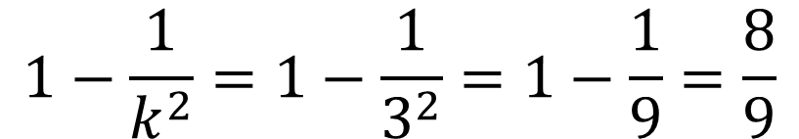
Chebyshev’s Theorem
For any set of numbers, regardless of how they are distributed, the fraction of them that lie within k standard deviations of their mean (where k > 1) is at least
What is the minimum percentage of the items in a data set which lie within 3 standard deviations of the mean?
Solution
With k = __3_, we calculate
$$1−\frac{1}{k^{2}}=1−\frac{1}{3^{2}}=1−\frac{1}{9}=\frac{8}{9}$$

Slide 11
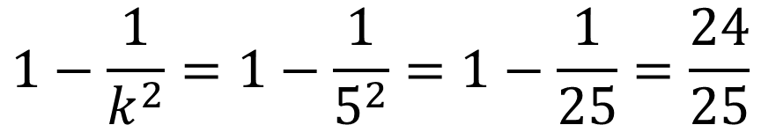
Chebyshev’s Theorem - Example
In a certain distribution, the mean is 60 with a standard deviation of 4. At least what fraction of the numbers are between the following pair of numbers? 40 and 80
Solution
The distance from the mean (60) to the LEFT boundary (40) is 60 – 40 = 20.
The distance from the RIGHT boundary (80) to the mean (60) is 80 – 60 = 20.
Since the standard deviation is 4, then DIVIDE the distance of 20 by 4: 20 ÷ 4 = 5.
That means the boundaries are FIVE (5) standard deviations from the mean, so k = 5.
By Chebyshev’s Rule, the fraction of numbers between 40 and 80 is
$$1−\frac{1}{k^{2}}=1−\frac{1}{5^{2}}=1−\frac{1}{25}=\frac{24}{25}$$

Slide 12

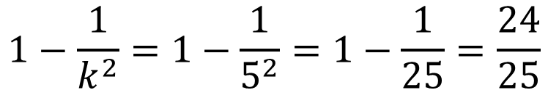
Chebyshev’s Theorem - Example
In a certain distribution where the mean is 70 with a standard deviation of 4, find the largest fraction of the numbers that could meet the following requirements:
less than 50 or more than 90
Solution
The distance from the mean (70) to either boundary is 70 – 50 = 90 – 70 = 20.
Since the standard deviation is 4, then DIVIDE 20 by 4 to get k. So, k = 20 ÷ 4, or k = 5.
The fraction of numbers that are BETWEEN 50 and 90 would be:
So the fraction of numbers for this problem (less than 50 or more than 90) would be what is LEFT OVER from 1, or what is NOT between 50 and 90:
$$1−\frac{1}{k^{2}}=1−\frac{1}{5^{2}}=1−\frac{1}{25}=\frac{24}{25}$$
$$1−\frac{24}{25}=\frac{1}{25}$$

